Slide 1
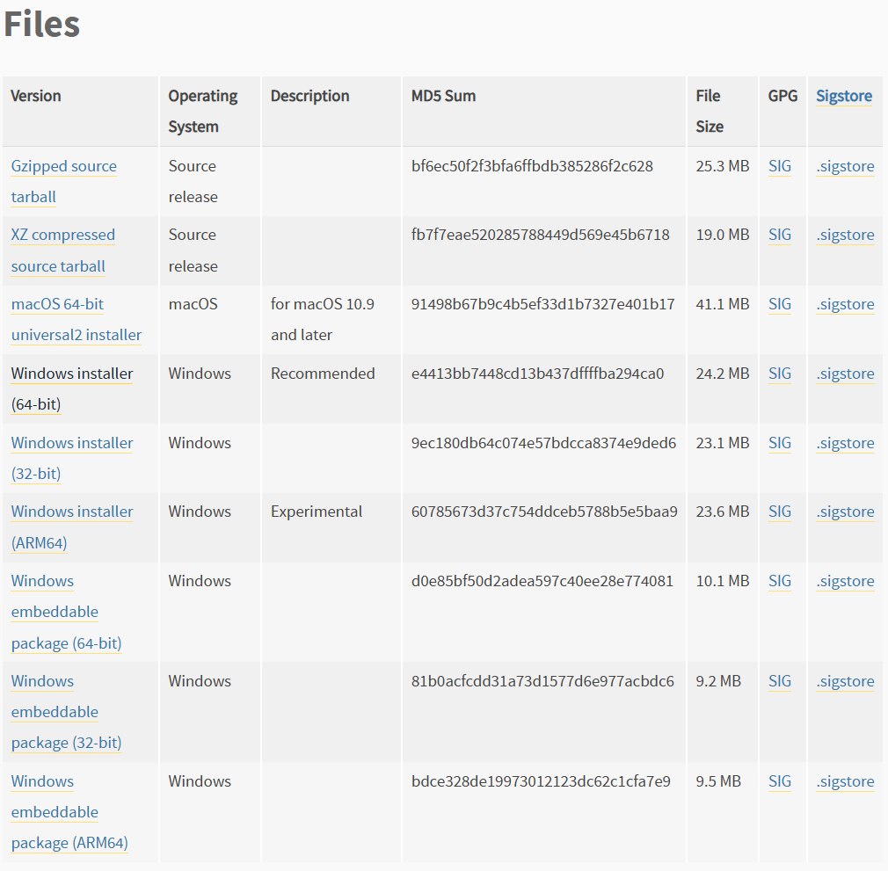
Python Environment:
Use Python 3.11.4
https://www.python.org/downloads/release/python-3114/
Download “Windows installer (64-bit)”
Pip install pandas
Pip install numpy
Pip install matplotlib
Pip install seaborn
Pip install scikit-learn
Pip install tensorflow

Slide 2
Decision tree Regression
polynomial Regression
XGBoost
Simple linear regression
Gradient Boosting Regression
Multiple linear regression
Non-Linear Regression
Regression
Linear Regression
Random Forest Regression
Ridge Regression
Support Vector Regression
Specialized Regression
Lasso Regression
Quantile Regression
Logistic Regression
Principal component Regression
Poisson Regression
Partial Least Regression
Elastic Net

Slide 3
Support Vector Machine
XG Boost
Random Forest
K-Nearest Neighbors
Logistic regression
Decision Tree
Naïve Bayes
Linear Discriminant Analysis (LDA)
Neural Network / Deep Learning

Slide 4
Q&A
How many classifier
How many regressor
How many Dimension Reduction : PCA & K-Means
What is LDA & QDA
What is the difference between scale() and StandardScaler()
Which scaler to use (min-max, standard, etc)
To-Do List
1. For all model learn, classify if they are (classifier/regressor), (supervised/unsupervised), and what are the predictors allowed (categorical/continuous)

Slide 5
Regression model
Linear Regression
Classification model
1.

Slide 6
Model | Y Type | X Type | Task Type | Learning Type | Advantage | Disadvantage
Linear Regression | Continuous | Numerical | Regression | Supervised
Logistic Regression | Categorical | Numerical | Classification | Supervised
Linear Discriminant Analysis (LDA) | Categorical | Numerical | Classification | Supervised
Quadratic Discriminant Analysis (QDA) | Categorial | Numerical | Classification | Supervised
K-Nearest Neighbors (KNN) | Categorical / Continuous | Numerical | Both | Supervised
Decision Tree | Categorical / Continuous | Numerical/Category | Both | Supervised
Random Forest | Categorical/Continuous | Numerical/Category | Both | Supervised

Slide 7
Model | Y Type | X Type | Task Type | Learning Type | Advantage | Disadvantage
Bagging | Categorical/Continuous | Numerical/Categorical | Both | Supervised
Boosting | Categorical/Continuous | Numerical/Categorical | Both | Supervised
Support Vector Machine (SVM) | Categorical | Numerical | Classification | Supervised
Principal Component Analysis (PCA) | N/A | Numerical | N/A | Unsupervised
Clustering (K-Means) | N/A | Numerical | N/A | Unsupervised
Neural Network | Categorical/Continuous | Numerical | Both | Supervised
Random Forest | Categorical/Continuous | Numerical/Category | Both | Supervised

Slide 8
Model | Y Type | X Type | Task Type | Learning Type | Advantage | Disadvantage
Lasso Regression | Continuous | Regression | Both | Supervised
Boosting | Categorical/Continuous | Numerical/Categorical | Both | Supervised
Support Vector Machine (SVM) | Categorical | Numerical | Classification | Supervised
Principal Component Analysis (PCA) | N/A | Numerical | N/A | Unsupervised
Clustering (K-Means) | N/A | Numerical | N/A | Unsupervised
Neural Network | Categorical/Continuous | Numerical | Both | Supervised
Random Forest | Categorical/Continuous | Numerical/Category | Both | Supervised

Slide 9
Response Variable (Y)
Categorial
Either one
Continuous
Categorial
Categorial
Categorial

